Slide 1
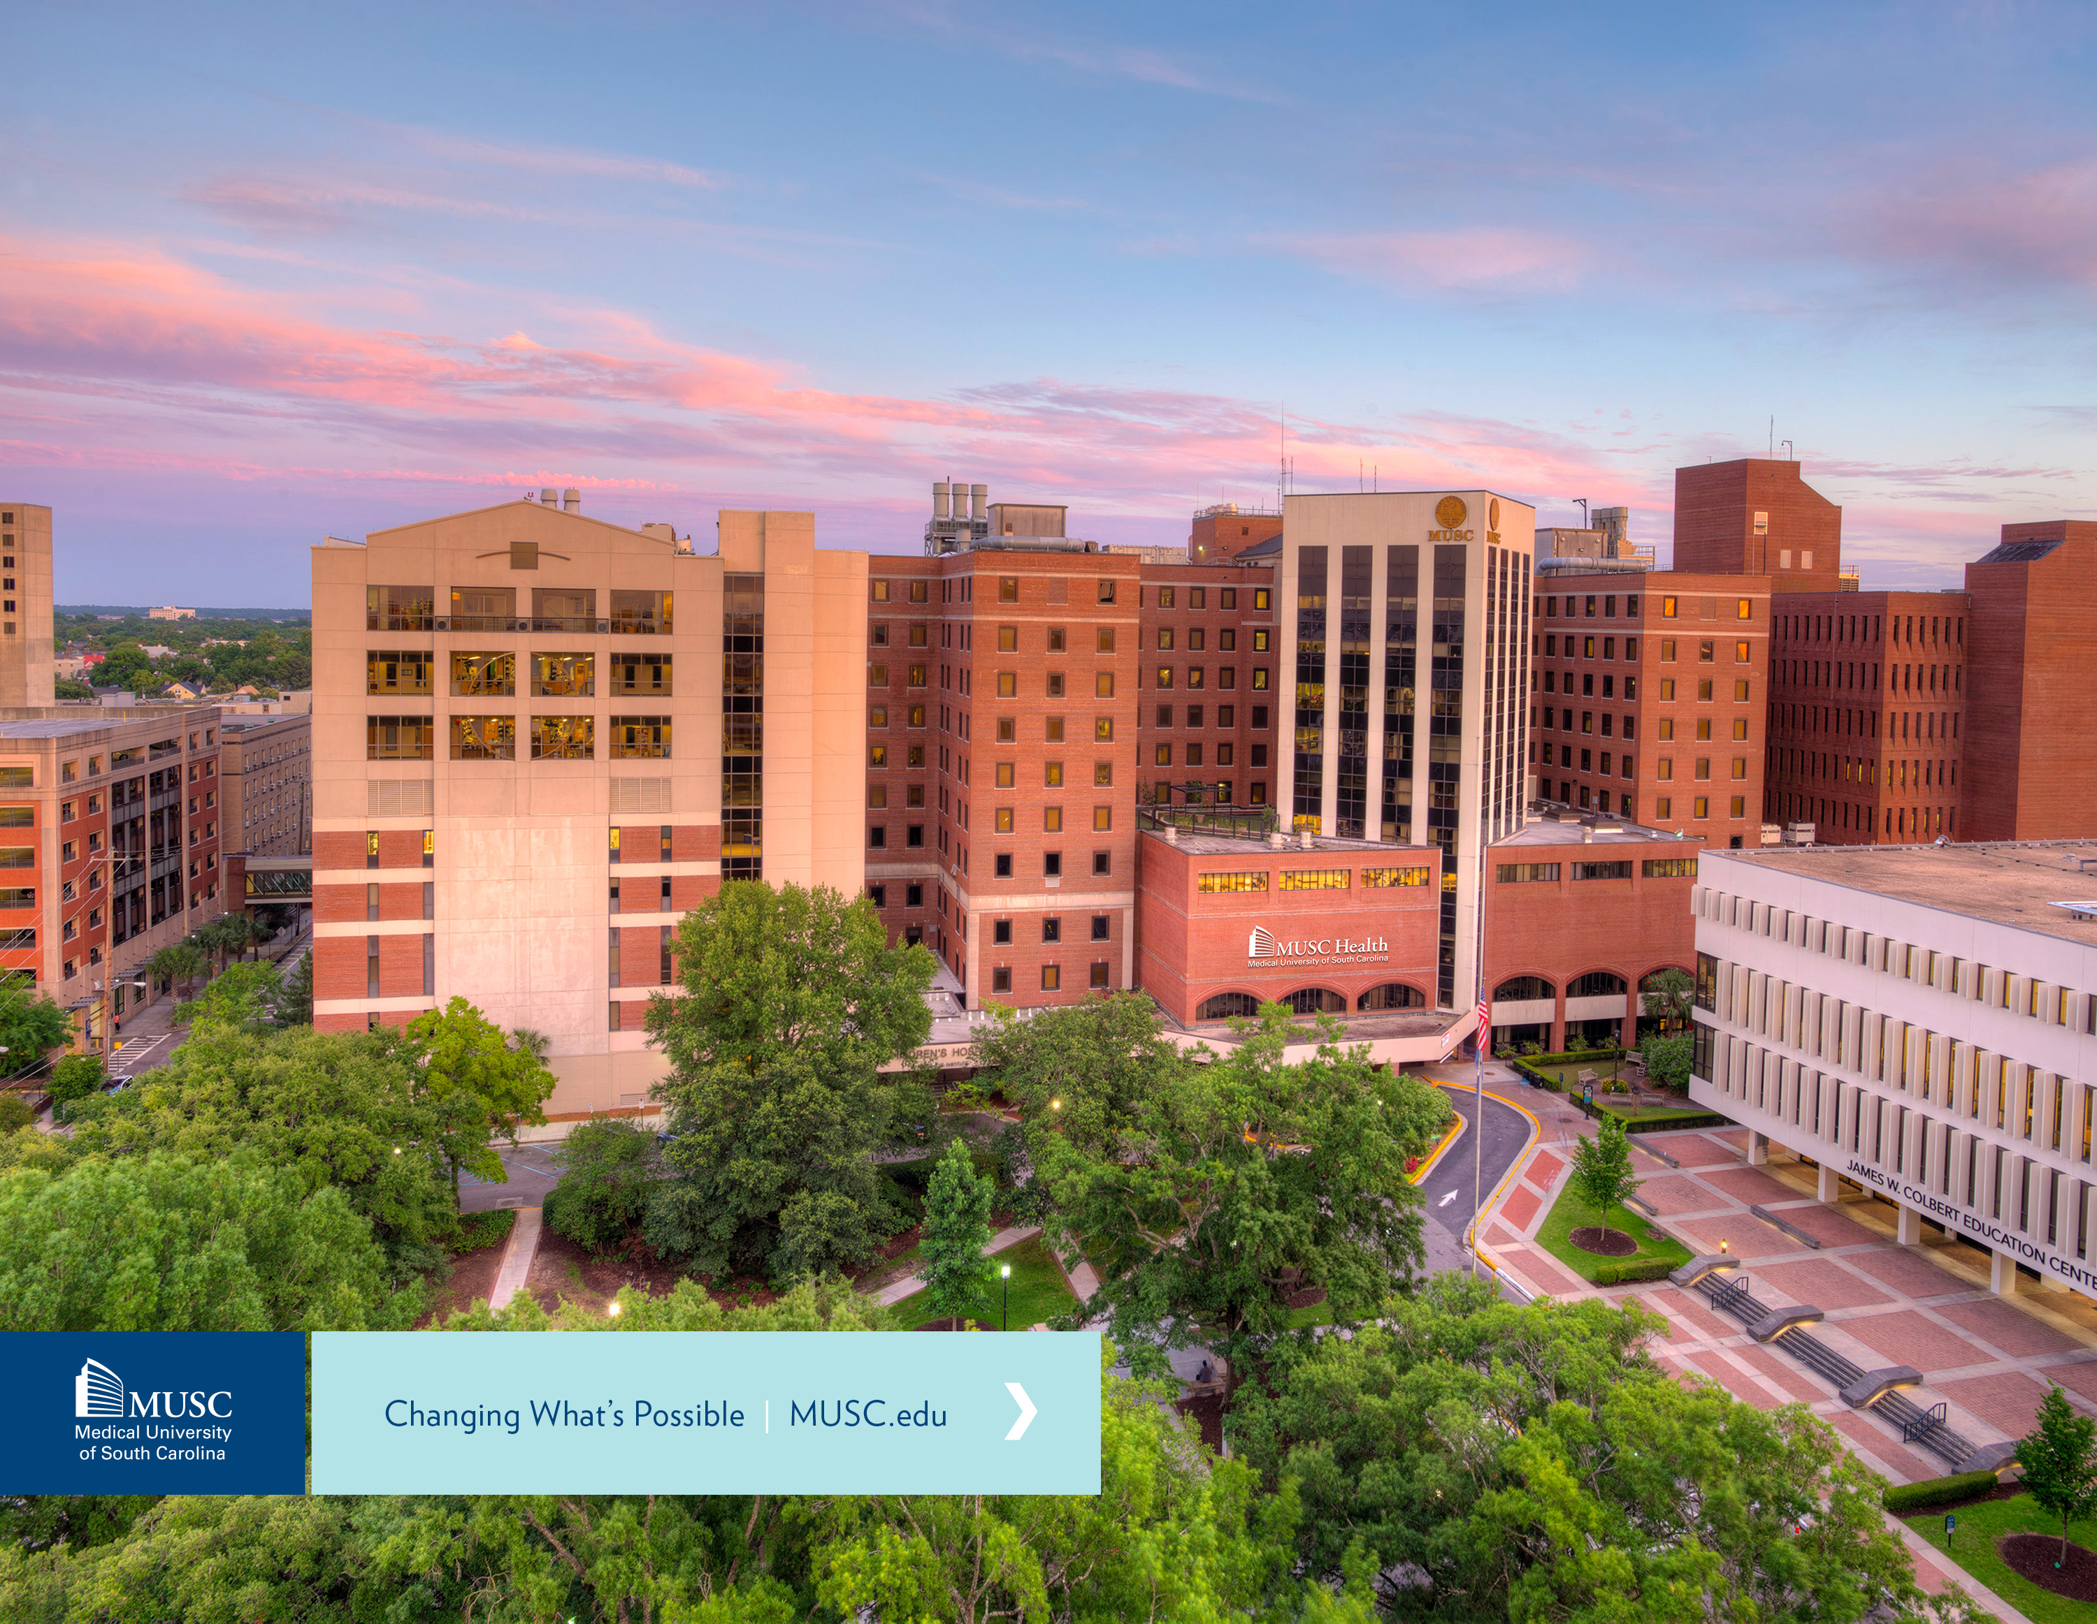
Medical University of South Carolina
SC House Ways and Means Higher Education Budget Subcommittee
Budget Request FY2019-20
January 22, 2019
Presented by Lisa Montgomery, MHA, Executive Vice President for Finance and Operations

Slide 2
MUSC Health Highlights
Over one million patient visits per year
U.S. News & World Report again ranked MUSC #1 hospital in SC; 6 of our pediatric specialties in the top 50 programs across the nation
10 nationally-ranked programs in U.S. News and World Report (top 1% of similar U.S. hospitals)
MUSC was named one of the first national Telehealth Centers of Excellence and awarded a grant from the U.S. Department of Health and Human Services
Created Lowcountry Stroke Collaborative in partnership with Roper St. Francis Healthcare

Slide 3
University Highlights
Three-year medical school curriculum: MUSC is one of 15 schools in the country with an option for medical students to graduate in three years instead of four, reducing tuition by one full year.
MUSC has a signed agreement with Clemson and Francis Marion to accept undergraduate students after three years (90 credit hours). Upon successfully completing the first year at MUSC, the undergraduate institution will award the bachelor’s degree. This program reduces undergraduate tuition by a year. This has been offered to all state supported undergraduate universities in South Carolina.
MUSC in partnership with all SC technical colleges now offers a Bachelor in Healthcare Studies Program. Students complete their first two years at a technical college while taking prerequisites for our graduate healthcare programs. Students then apply to MUSC for their final two years which can be completed online. Upon completion, students can apply to MUSC graduate programs with a reduced amount of undergraduate debt.

Slide 4
Diversity and Inclusion
For the second consecutive year, Forbes recognized MUSC among “America’s 2019 Best Employers for Diversity.”
MUSC College of Medicine continues to be ranked among the nation’s best to enroll and graduate African American males in medicine.
Two new leadership development programs launched in 2018: Master Class for Inclusion Practitioners and the David J. and Kathryn Cole BRIHTE Leadership Academy.
MUSC Health co-hosted the 2nd Annual Tri-County Health Symposium and launched the Healthy Tri-County 5-year Action Plan. Both were in conjunction with Roper St. Francis Healthcare and Trident United Way in an effort to address the Community Health Needs Assessments findings conducted by the group.

Slide 5
In-state vs. Out-of-state Students

Slide 6
MUSC Appropriations History
 | FY2015-16 | FY2016-17 | FY2017-18 | FY2018-19
Recurring | $62,149,912 | $65,290,124 | $69,795,296 | $75,833,525
Non-recurring (Other) | $858,662 | $28,807 | $30,351 | $34,480
Non-recurring Capital | $372,904 |  |  | $3,500,000
Total | $63,381,478 | $65,318,931 | $69,825,647 | $79,368,005

Slide 7
Authorized Revenues by Source FY2018-19 MUSC Board of Trustees
Approved Budget

Slide 8
Authorized Expenses FY2018-19 MUSC Board of Trustees
Approved Budget

Slide 9
Carry Forward Unrestricted Net Position per CAFR
*TBD – cannot yet determine the impact of GASB 68 and 75 on net position.
 | FY2016-17 | FY2017-18 | FY2018-19
Recurring | $0 | $0 | $0
Non-recurring | $0 | $0 | $0
Other | $(210,186,980) | $(675,452,094) | *
Federal | $0 | $0 | $0

Slide 10
Capital Projects (1 of 3)
10

Slide 11
Capital Projects (2 of 3)
11

Slide 12
Capital Projects (3 of 3)
12

Slide 13
Maintenance (Capital Renewal)
Our current backlog is over $50 million and our projected need over the next 10-years is approximately an additional $160 million for a total $210 million.
Capital Projects are included on the previous slides.
Capital Renewal
In FY2017-18, MUSC spent $4 million on capital renewal needs.
In FY2018-19, MUSC budgeted $10 million of institutional funds for capital renewal
$4 million Capital Renewal Funds
$6 million, Harborview Towers sale proceeds
In FY2018-19, received $3.5 million Capital Renewal Funds (State Appropriation)
Every three years, MUSC engages an external consultant to assess building conditions and determine deferred maintenance and 10-year capital renewal needs.

Slide 14
FY2019-20 Revenue Authorization Request

Slide 15
FY2019-20 Expenses Authorization Request

Slide 16
Recurring Request
Request | Amount | Description
College of Pharmacy Building Renovation Debt Service | $4,850,471 | Funds required to resolve accreditation concerns with inadequacy of the College of Pharmacy structure by providing a state-of-the-art academic and student support space. The project would include: A new two-story addition to the existing building Basic Science Building for the College of Pharmacy. Renovate underutilized existing space to provide new flexible classroom and instructional space for collaborative 21st century pedagogy across all six colleges. This would include updated Simulation & Innovation Centers and skills labs, Virtual Reality demonstration space, and accommodating newly established College of Medicine flex curriculum and accelerated programs. The project will also provide expanded College of Medicine student support space to comply with accreditation guidelines.
Pension Employer Contribution Recoupment | $13,248,116 | Recoup the Enterprise pension increases that began in FY2018 net of the credit from PEBA
134 Additional Positions (2 federal, 132 other) | $0 | See slide 21

Slide 17
Non-recurring Request
Request | Amount | Description
None requested

Slide 18
Capital Request
Request | Amount | Description
FY2019-20 Capital Renewal | $25,000,000 | To maintain critical systems (mechanical, electrical, plumbing, exterior façade, roofs, conveyance and building envelope)
Interprofessional Health/ Innovation Projects | $53,000,000 | Consolidate student services Expand distance learning programs, renovate Renovate Colbert Library for College of Medicine academic services Addition for Basic Science Building to relocate College of Pharmacy classrooms
Renovation Projects | $15,000,000 | Renovation and backfill of existing University space to ensure alignment of academic and clinical missions

Slide 19
Other Fund Request
Request | Amount | Revenue Source | Description
FY2019-20 Other Fund Changes | $26,878,651 | Clinical revenue, private gifts, and grants | Clinical operations to include new Children’s Hospital Growth in clinical trials and research programs College of Nursing growth in enrollment Growth in online learning programs

Slide 20
Federal Fund Request
Request | Amount | Revenue Source | Description
FY2019-20 Federal Fund Changes | $8,128,280 | Federal | Growth in cancer research Support sustainability for the growth of research program Growth basic science research in Pediatrics and clinical research relating to the new Children’s Hospital

Slide 21
FTE Request
Request | Amount | Revenue Source | Description
FY2019-20 Additional FTEs | $0 | Relative to “Other Request” funded by clinical revenue and private gifts | 134 FTEs are requested for FY2019-20 to support expansion of clinical access, addition of new programs, and expansion in research. Request: 132 other and 2 federal Programs and clinical initiative include areas such as: new MUSC Children's Hospital in areas such as Cardiology, Critical Care, Neonatology, Emergency, Adolescent Medicine, Nephrology, Pulmonology, and Neurology; digital accessibility across the campus and to support the expansion of online learning programs and course design; expansion of clinical services to reach entire state of South Carolina related to the prevention, screening and early detection of cancer; obesity-related initiatives, expansion of diabetes management services and patient access within general gastroenterology and electrophysiology; expansion of opioid treatment programs including telehealth initiatives; growth of Cardiology Research Programs; telehealth transplant initiative for pre/post transplant patients in regional clinics; growth of the Cardiology Research program; and to expand development activities.

Slide 22
Provisos
Section | Action
23.1. (MUSC: Rural Dentist Program) The Rural Dentist Program, in coordination with the Department of Health and Environmental Control's Public Health Dentistry Program, is established at the Medical University of South Carolina. The funds appropriated to the Medical University of South Carolina for the Rural Dentist Program shall be administered by the South Carolina Area Health Education Consortium physician recruitment office. The costs associated with administering this program are to be paid from the funds appropriated to the Rural Dentist Program and shall not exceed four percent of the appropriation. The Medical University of South Carolina is responsible for the fiscal management of funds to ensure that state policies and guidelines are adhered to. MUSC shall be permitted to carry forward unspent general funds appropriated to the Rural Dentist program provided that these funds be expended for the program for which they were originally designated. A board is created to manage and allocate these funds to insure the location of licensed dentists in rural areas of South Carolina and on the faculty of the College of Dental Medicine at MUSC. The board will be composed of the following: the Dean, or his designee, of the MUSC College of Dental Medicine; three members from the South Carolina Dental Education Foundation Board who represent rural areas; and the President, or his designee, of the South Carolina Dental Association. The Director of DHEC's Office of Primary Care; the Director or his designee of the Department of Health and Human Services; and the Executive Director of the South Carolina Dental Association shall serve as ex officio members without vote. This board shall serve without compensation. | Keep
23.2. (MUSC: Rural Access Plan) The MUSC Hospital Authority, in conjunction with the Department of Health and Human Services, shall study how to partner with existing rural hospitals to ensure that these regions maintain access to medical care. | Keep

Slide 23
Appendix

Slide 24
FY2019-20 Revenue Authorization Request Other Funds

Slide 25
Annual Student Admissions/Enrollment

Slide 26
Student Ethnicity, Race, & Gender

Slide 27
Headcount vs. FTEs

Slide 28
Fall 2018 Enrollment by College

Slide 29
Student Enrollment (Doctoral)
Degree of Study – Doctoral | Fall 2018 Enrollment (Headcount) | Fall 2018 Enrollment (FTE)
Doctor of Dental Medicine (including DMD/PhD) | 300 | 300
Doctor of Health Administration | 74 | 74
Doctor of Medicine (including MD/PhD) | 743 | 743
Doctor of Nurse Anesthesia Practice | 57 | 56
Doctor of Nursing Practice | 224 | 197
Doctor of Pharmacy (including PharmD/PhD) | 313 | 310
Doctor of Philosophy - Health and Rehabilitation Sciences | 12 | 11
Doctor of Philosophy - Nursing | 32 | 21
Doctor of Physical Therapy | 189 | 188

Slide 30
Student Enrollment (Doctoral) (continued)
Degree of Study – Doctoral | Fall 2018 Enrollment (Headcount) | Fall 2018 Enrollment (FTE)
PhD in Biomedical Data Sciences and Informatics | 2 | 2
PhD in Biomedical Imaging | 5 | 5
PhD in Biostatistics | 15 | 15
PhD in Biochemistry & Molecular Biology | 20 | 19
PhD in Drug Discovery & PhD in Drug Discovery - Post PharmD | 14 | 14
PhD in Epidemiology | 9 | 9
PhD in Microbiology & Immunology | 13 | 13
PhD in Molecular & Cell Biology & Pathology | 25 | 25
PhD in Neuroscience | 24 | 24
PhD in Cell & Molecular Pharmacology & Exp. Therapy | 14 | 14

Slide 31
Student Enrollment (Other)
Degree of Study – Other | Fall 2018 Enrollment (Headcount) | Fall 2018 Enrollment (FTE)
Master in Health Administration | 97 | 91
Master of Public Health | 30 | 27
Master of Science in Biomedical Science | 15 | 15
Master of Science in Cardiovascular Perfusion | 52 | 51
Master of Science in Clinical Research | 23 | 20
Master of Science in Dentistry | 21 | 21
Master of Science in Health Informatics | 22 | 21
Master of Science in Medical Sciences | 17 | 17
Master of Science in Nurse Anesthesia | 27 | 27
Master of Science in Nursing | 9 | 7
Master of Science in Occupational Therapy | 94 | 93
Master of Science in Physician Assistant Studies | 121 | 120
Bachelor of Science in Healthcare Studies | 18 | 16
Bachelor of Science in Nursing | 311 | 308
Certificate in Clinical Pharmacy Practice | 2 | 2
Non-degree seeking | 21 | 7

Slide 32
Graduation Data
MUSC does not have first time students and the graduation rate is calculated for each academic program by looking backwards to determine the incoming cohort for which the year being assessed represents 150% of the published length of the program, and then determining how many of those students have graduated within that time.
Of the 32,117 living alumni in MUSC’s database, 18,195 are South Carolina residents.

Slide 33
Tuition History

Slide 34
2018-19 Tuition & Fee Schedule

Slide 35
2018-19 Tuition & Fee Schedule

Slide 36
Undergraduate Scholarships & Grants

Slide 37
Undergraduate Scholarships & Grants

Slide 38
Outstanding Bond Debt

Slide 39
Employees FY2018-19 Authorized FTEs
FTEs | Authorized
State | 1,119.69
Other | 2,103.04
Federal | 437.44
Total | 3,660.17

Slide 40
Number of Students Per Faculty (2018-19)
Notes:
Data provided by the Office of Institutional Effectiveness.
Numerator the N of students enrolled, according to OEM published data, in each college in 2017 (Enrollment Figures, OEM website – Enrollment report accurate as of Sept (Fall) of year prior to current year)
Denominator is the N of faculty MUSC reports in its Faculty File, submitted each November (November 30 of current year) to the CHE.
The resulting value shows the number of students per faculty member in each college.
The chart does not contain the College of Graduate Studies because there are no faculty with primary appointments in that College

Slide 41
University & Hospital Senior Leadership
Race | Leaders | %
Asian | 2 | 9.52%
African American | 4 | 19.05%
Caucasian | 15 | 71.43%
Total | 21 | 100.00%

Slide 42
University & Hospital Senior Leadership
Gender | Leaders | %
Female | 11 | 52.38%
Male | 10 | 47.62%
Total | 21 | 100.00%

Slide 43
University Workforce All University Employees
Race | Count | %
American Indian/Alaska Native | 6 | 0.11%
Asian | 485 | 8.83%
African American | 640 | 11.66%
Hispanic/Latino | 187 | 3.41%
Native Hawaiian/Other Pacific Islander | 6 | 0.11%
Two or More Races | 79 | 1.44%
Unspecified | 101 | 1.84%
Caucasian | 3,986 | 72.60%
Total | 5,490 | 100.00%

Slide 44
University Workforce Faculty, Unclassified Non-faculty, Classified, and Research Grant Employees
Race | Amount | %
American Indian/Alaska Native | 5 | 0.13%
Asian | 314 | 8.04%
African American | 512 | 13.11%
Hispanic/Latino | 119 | 3.05%
Native Hawaiian/Other Pacific Islander | 5 | 0.13%
Two or More Races | 58 | 1.49%
Unspecified | 45 | 1.14%
Caucasian | 2,847 | 72.91%
Total | 3,905 | 100.00%

Slide 45
University Full-time Equivalent Employees
Classification | Count
Classified Full-time | 1,640
Classified Part-time | 63
Faculty Full-time | 1,257
Faculty Part-time | 322
Temporary Full-time | 38
Temporary Part-time | 137
Temporary Faculty Full-time | 20
Temporary Faculty Part-time | 175
Total | 3,652

Slide 46
Deferred Maintenance & Capital Renewal

